Slide 1
Understanding Groups
Group
  Two or more interacting and interdependent individuals who come together to achieve specific goals.
  Formal groups
    Work groups defined by the organization’s structure that have designated work assignments and tasks.
      Appropriate behaviors are defined by and directed toward organizational goals.
  Informal groups
    Groups that are independently formed to meet the social needs of their members.
© 2007 Prentice Hall, Inc. All rights reserved.
15–<number>

Slide 2
Exhibit 15–1 Examples of Formal Groups
Command Groups
  Groups that are determined by the organization chart and composed of individuals who report directly to a given manager.
Task Groups
  Groups composed of individuals brought together to complete a specific job task; their existence is often temporary because once the task is completed, the group disbands.
© 2007 Prentice Hall, Inc. All rights reserved.
15–<number>

Slide 3
Exhibit 15–1 Examples of Formal Groups (cont’d)
Cross-Functional Teams
  Groups that bring together the knowledge and skills of individuals from various work areas or groups whose members have been trained to do each others’ jobs.
Self-Managed Teams
  Groups that are essentially independent and in addition to their own tasks, take on traditional responsibilities such as hiring, planning and scheduling, and performance evaluations.
© 2007 Prentice Hall, Inc. All rights reserved.
15–<number>

Slide 4
Stages in Group Development
Forming
  Members join and begin the process of defining the group’s purpose, structure, and leadership.
Storming
  Intragroup conflict occurs as individuals resist control by the group and disagree over leadership.
Norming
  Close relationships develop as the group becomes cohesive and establishes its norms for acceptable behavior.
Performing
  A fully functional group structure allows the group to focus on performing the task at hand.
Adjourning
  The group prepares to disband and is no longer concerned with high levels of performance.
© 2007 Prentice Hall, Inc. All rights reserved.
15–<number>

Slide 5
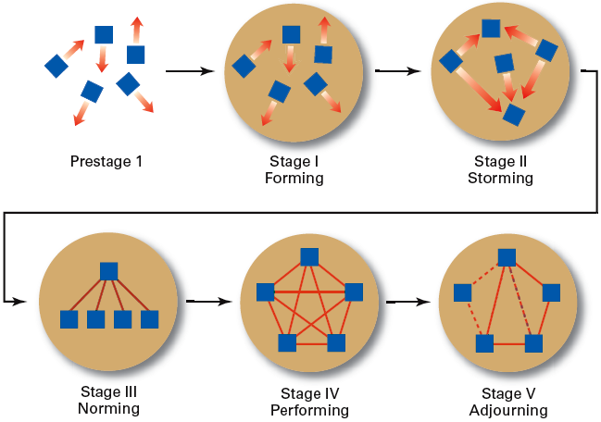
Exhibit 15–2 Stages of Group Development
© 2007 Prentice Hall, Inc. All rights reserved.
15–<number>

Slide 6
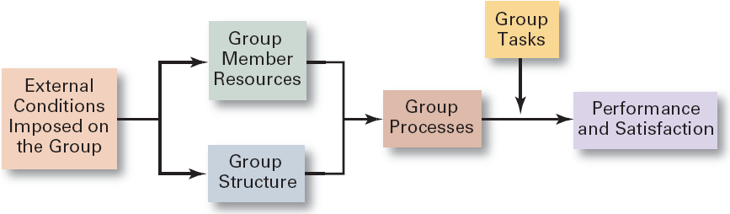
Exhibit 15–3 Group Behavior Model
© 2007 Prentice Hall, Inc. All rights reserved.
15–<number>

Slide 7
Work Group Behavior
Internal Variables Affecting Group Behavior
  The individual abilities of the group’s members
  The size of the group
  The level of conflict
  The internal pressures on members to conform to the group’s norms
© 2007 Prentice Hall, Inc. All rights reserved.
15–<number>

Slide 8
Conditions Affecting Group Behavior
External (Organizational) Conditions
  Overall strategy
  Authority structures
  Formal regulations
  Available organizational resources
  Employee selection criteria
  Performance management (appraisal) system
  Organizational culture
  General physical layout
Internal Group
Variables
  Individual competencies and traits of members
  Group structure
  Size of the group
  Cohesiveness and the level of intragroup conflict
  Internal pressures on members to conform o the group’s norms
© 2007 Prentice Hall, Inc. All rights reserved.
15–<number>

Slide 9
Group Structure
Role
  The set of expected behavior patterns attributed to someone who occupies a given position in a social unit that assist the group in task accomplishment or maintaining group member satisfaction.
  Role conflict: experiencing differing role expectations
  Role ambiguity: uncertainty about role expectations
© 2007 Prentice Hall, Inc. All rights reserved.
15–<number>

Slide 10
Group Structure (cont’d)
Norms
  Acceptable standards or expectations that are shared by the group’s members.
Common types of norms
  Effort and performance
    Output levels, absenteeism, promptness, socializing
  Dress
  Loyalty
© 2007 Prentice Hall, Inc. All rights reserved.
15–<number>

Slide 11
Group Structure (cont’d)
Conformity
  Individuals conform in order to be accepted by groups.
  Group pressures can have an effect on an individual member’s judgment and attitudes.
  The effect of conformity is not as strong as it once was, although still a powerful force.
  Groupthink
    The extensive pressure of others in a strongly cohesive or threatened group that causes individual members to change their opinions to conform to that of the group.
© 2007 Prentice Hall, Inc. All rights reserved.
15–<number>

Slide 12
Group Structure (cont’d)
Status System
  The formal or informal prestige grading, position, or ranking system for members of a group that serves as recognition for individual contributions to the group and as a behavioral motivator.
    Formal status systems are effective when the perceived ranking of an individual and the status symbols accorded that individual are congruent.
© 2007 Prentice Hall, Inc. All rights reserved.
15–<number>

Slide 13

Group Structure: Group Size
Small groups
  Complete tasks faster than larger groups.
  Make more effective use of facts.
Large groups
  Solve problems better than small groups.
  Are good for getting diverse input.
  Are more effective in fact-finding.
Social Loafing
  The tendency for individuals to expend less effort when working collectively than when work individually.
© 2007 Prentice Hall, Inc. All rights reserved.
15–<number>

Slide 14

Group Structure (cont’d)
Group Cohesiveness
  The degree to which members are attracted to a group and share the group’s goals.
    Highly cohesive groups are more effective and productive than less cohesive groups when their goals aligned with organizational goals.
© 2007 Prentice Hall, Inc. All rights reserved.
15–<number>

Slide 15
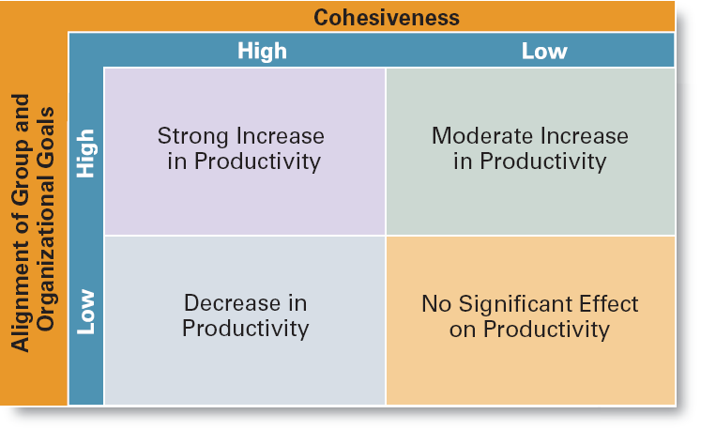
Exhibit 15–5 The Relationship Between Cohesiveness and Productivity
© 2007 Prentice Hall, Inc. All rights reserved.
15–<number>

Slide 16
Group Processes: Group Decision Making
Advantages
  Generates more complete information and knowledge.
  Generates more diverse alternatives.
  Increases acceptance of a solution.
  Increases legitimacy of decision.
Disadvantages
  Time consuming
  Minority domination
  Pressures to conform
  Ambiguous responsibility
© 2007 Prentice Hall, Inc. All rights reserved.
15–<number>

Slide 17
Exhibit 15–6 Group versus Individual Decision Making
Criteria of Effectiveness Groups Individuals
Accuracy ✓
Speed ✓
Creativity ✓
Degree of acceptance ✓
Efficiency ✓
© 2007 Prentice Hall, Inc. All rights reserved.
15–<number>

Slide 18
Group Processes: Conflict Management
Conflict
  The perceived incompatible differences in a group resulting in some form of interference with or opposition to its assigned tasks.
    Traditional view: conflict must be avoided.
    Human relations view: conflict is a natural and inevitable outcome in any group.
    Interactionist view: conflict can be a positive force and is absolutely necessary for effective group performance.
© 2007 Prentice Hall, Inc. All rights reserved.
15–<number>

Slide 19
Group Processes: Conflict Management (cont’d)
Categories of Conflict
  Functional conflicts are constructive.
  Dysfunctional conflicts are destructive.
Types of Conflict
  Task conflict: content and goals of the work
  Relationship conflict: interpersonal relationships
  Process conflict: how the work gets done
© 2007 Prentice Hall, Inc. All rights reserved.
15–<number>

Slide 20
Group Processes: Conflict Management (cont’d)
Techniques to Reduce Conflict:
  Avoidance
  Accommodation
  Forcing
  Compromise
  Collaboration
© 2007 Prentice Hall, Inc. All rights reserved.
15–<number>

Slide 21
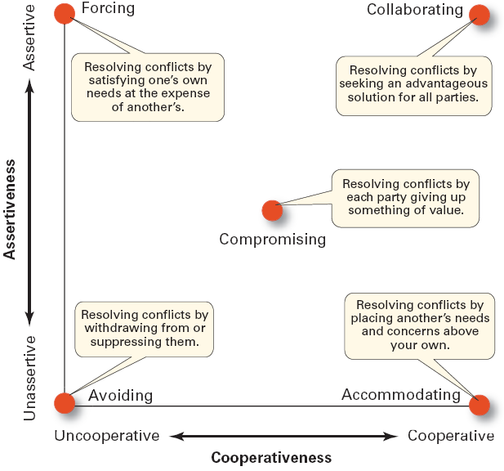
Exhibit 15–9 Conflict-Management Techniques
Source: Adapted from K.W. Thomas, “Conflict and Negotiation Processes in Organizations,” in M.D. Dunnette and L.M. Hough (eds.) Handbook of Industrial and Organizational Psychology, vol. 3, 2d ed. (Palo Alto, CA: Consulting Psychologists Press, 1992), p. 668. With permission
© 2007 Prentice Hall, Inc. All rights reserved.
15–<number>

Slide 22
Group Tasks and Group Effectiveness
Highly complex and interdependent tasks require:
  Effective communications: discussion among group members.
  Controlled conflict: More interaction among group members.
© 2007 Prentice Hall, Inc. All rights reserved.
15–<number>

Slide 23
What Is a Team?
Work Team
  A group whose members work intensely on a specific common goal using their positive synergy, individual and mutual accountability, and complementary skills.
Types of Teams
  Problem-solving teams
  Self-managed work teams
  Cross-functional teams
  Virtual teams
© 2007 Prentice Hall, Inc. All rights reserved.
15–<number>

Slide 24
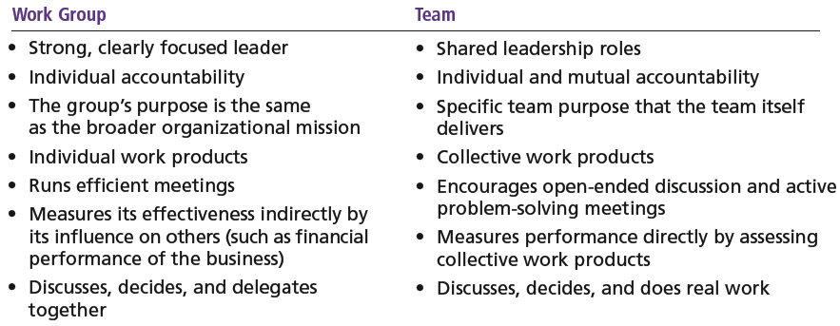
Exhibit 15–10 Groups versus Teams
© 2007 Prentice Hall, Inc. All rights reserved.
15–<number>

Slide 25
Types of Teams
Problem-solving Teams
  Employees from the same department and functional area who are involved in efforts to improve work activities or to solve specific problems.
Self-managed Work Teams
  A formal group of employees who operate without a manager and responsible for a complete work process or segment.
© 2007 Prentice Hall, Inc. All rights reserved.
15–<number>

Slide 26
Types of Teams (cont’d)
Cross-functional Teams
  A hybrid grouping of individuals who are experts in various specialties and who work together on various tasks.
Virtual Teams
  Teams that use computer technology to link physically dispersed members in order to achieve a common goal.
© 2007 Prentice Hall, Inc. All rights reserved.
15–<number>

Slide 27

Advantages of Using Teams
Teams outperform individuals.
Teams provide a way to better use employee talents.
Teams are more flexible and responsive.
Teams can be quickly
assembled, deployed,
refocused, and disbanded.
© 2007 Prentice Hall, Inc. All rights reserved.
15–<number>

Slide 28
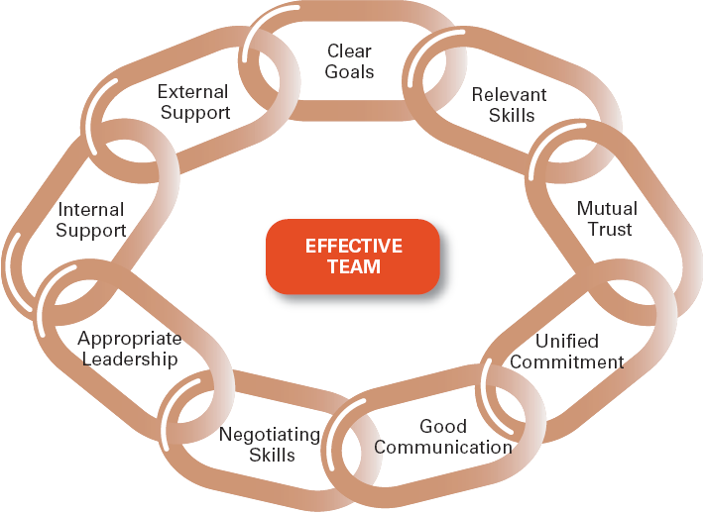
Exhibit 15–11 Characteristics of Effective Teams
© 2007 Prentice Hall, Inc. All rights reserved.
15–<number>

Slide 29
Characteristics of Effective Teams
Have a clear understanding of their goals.
Have competent members with relevant technical and interpersonal skills.
Exhibit high mutual trust in the character and integrity of their members.
Are unified in their commitment to team goals.
Have good communication systems.
Possess effective negotiating skills
Have appropriate leadership
Have both internally and externally supportive environments
© 2007 Prentice Hall, Inc. All rights reserved.
15–<number>

Slide 30

Current Challenges in Managing Teams
Getting employees to:
  Cooperate with others
  Share information
  Confront differences
  Sublimate personal interest for the greater good of the team
© 2007 Prentice Hall, Inc. All rights reserved.
15–<number>

Slide 31
Managing Global Teams
Group Member Resources
  Unique cultural characteristics of team members
  Avoiding stereotyping
Group Structure
  Conformity—less groupthink
  Status—varies in importance among cultures
  Social loafing—predominately a Western bias
  Cohesiveness—more difficult to achieve
Group processes—capitalize on diverse ideas
Manager’s role—a communicator sensitive to the type of globe team to use.
© 2007 Prentice Hall, Inc. All rights reserved.
15–<number>

Slide 32
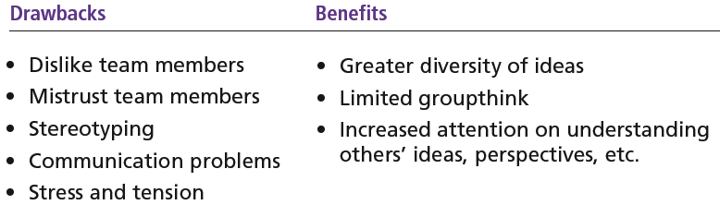
Exhibit 15–12 Drawbacks and Benefits of Global Teams
© 2007 Prentice Hall, Inc. All rights reserved.
15–<number>

Slide 33

Understanding Social Networks
Social Network
  The patterns of informal connections among individuals within groups
The Importance of Social Networks
  Relationships can help or hinder team effectiveness
  Relationships improve team goal attainment and increase member commitment to the team.
© 2007 Prentice Hall, Inc. All rights reserved.
15–<number>

